Slide 1
Welcome

Slide 2
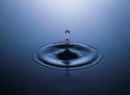
BEST PRACTICE UNDER IWMP BATCH-III
PATHANAPURAM BLOCK, KOLLAM

Slide 3
STATE :KERALA
DISTRICT :KOLLAM BLOCK :PATHANAPURAM PROJECT :IWMP III PIA :BLOCK PANCHAYATH
PATHANAPURAM
WATERSHED :KADAKKAMON

Slide 4
PRACTICE
40 household open wells in the draught affected locations of the watershed have been provided with devices for using roof water to recharge them

Slide 5
Nearly 24075 families
inhabit the project area
There are only 17437
open wells in the project area
Most of these wells
get dried up during summer
(about 5-6 months)

Slide 6
Affected families used to
deepen their wells every summer for getting water
instead of augmenting ground water recharge in the localities
They kept on wasting their hard earned money on thewasteful effort

Slide 7
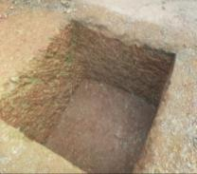
METHODOLOGY
The methodology adopted in the case is quite simple
The drainage from the rooftops is diverted by means of pipe lines to a recharge pit made near the well

Slide 8
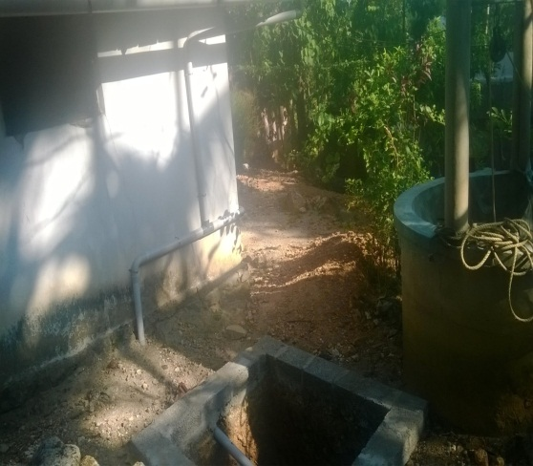
Lead line from the roof
The well
Recharge pit

Slide 9
Rain water
from the roof tops has thus been used to recharge the wells.
Members from benefited families have been identified as the User Groups

Slide 10
In most cases,
the house owners themselves had opened the pit
Many of them
belong to BPL category

Slide 11
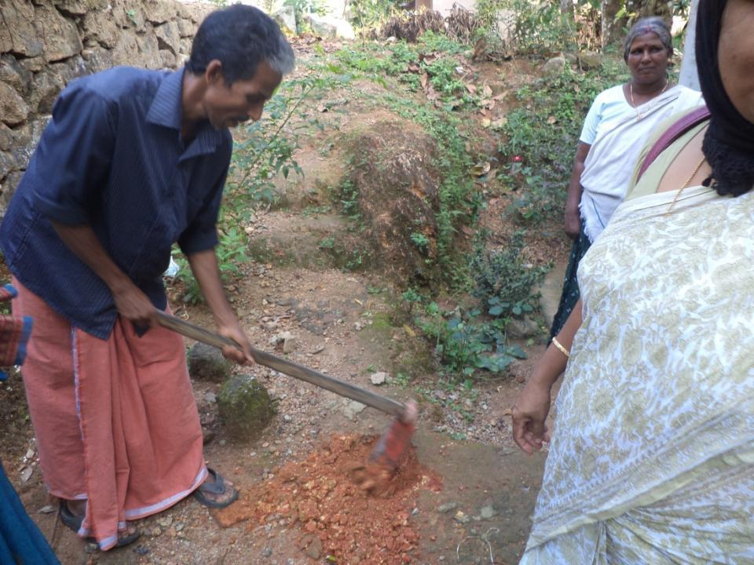
The House Owner Mr. M.B. Rameshan,
Renju Bhavanam, Punnala P.O,
Pathanapuram, Kollam Dist
opens a recharge pit by his well

Slide 12
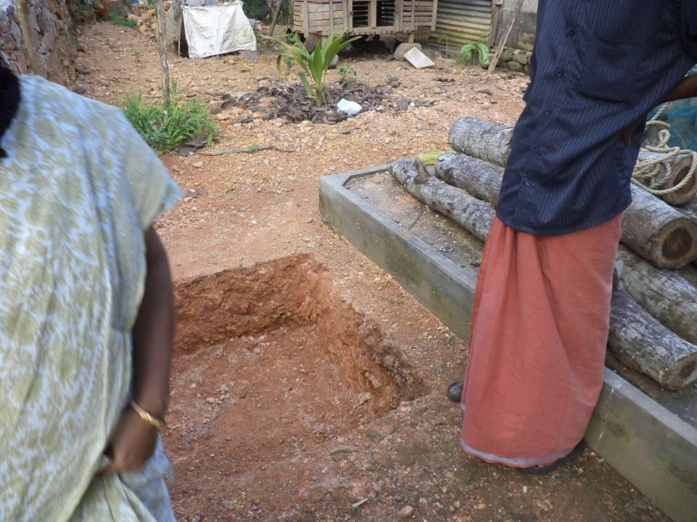
Slope direction

Slide 13
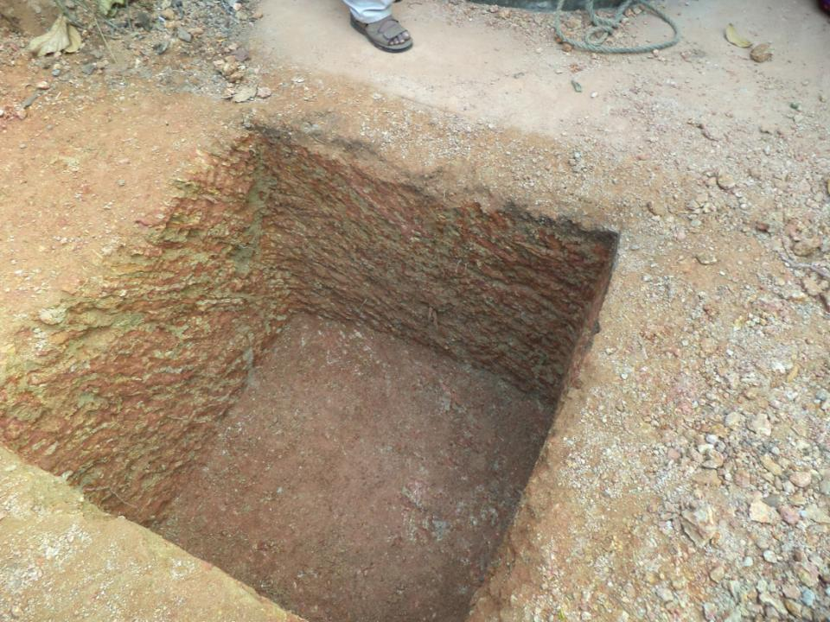
A typical recharge pit upstream the well

Slide 14
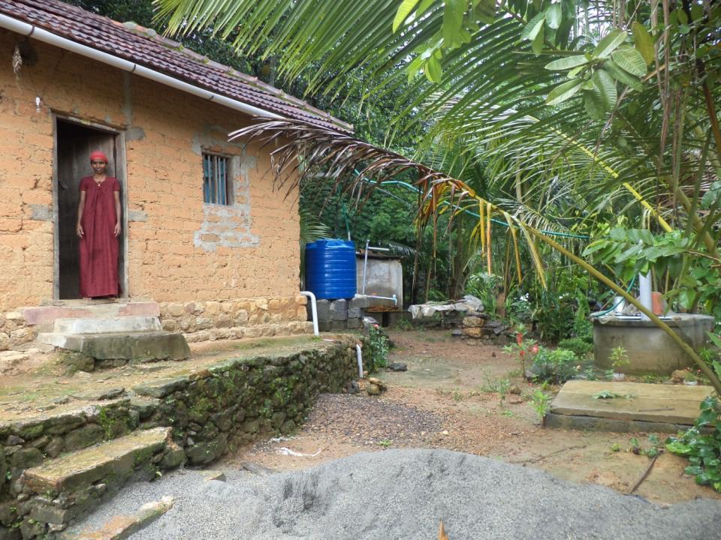
HOUSE OWNER:
PRAMEELA SURESH
AMMU NIVAS, PUNNALA(P.O)
PUNNALA,PATHANAPURAM,KOLLAM(DIST)
A recharge pit
covered with slab

Slide 15
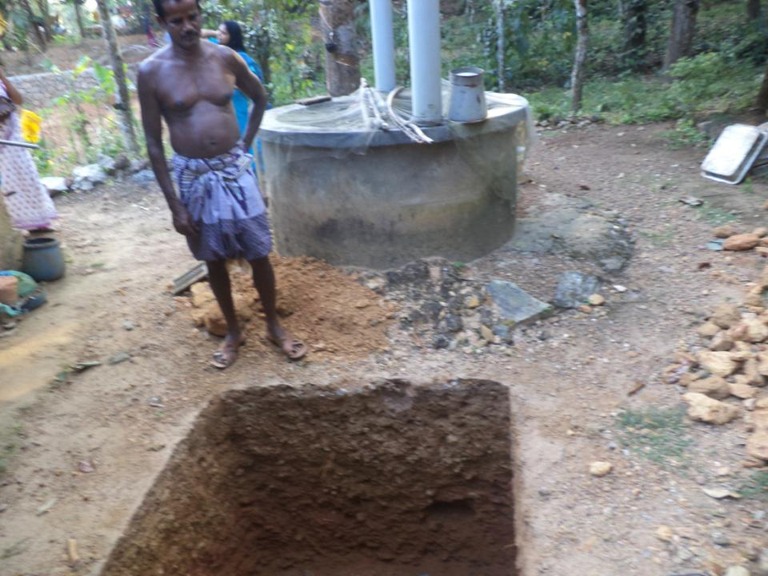
Another recharge pit

Slide 16
It was on of the EPAs

Slide 17
Rain water from about 4000 M2 of roof tops has been utilised by this The total quantity of rain water thus conserved amounts to about 9760 M3

Slide 18
IMPACT
The intervention generated good impacts.
All the 40 families could quite immediately avail the benefit of the summer rains
The water level in the wells have recorded an average rise of 0.9 -1.4 m

Slide 19
So also, the local ground water stock of the area has been substantially enhanced by the percolation envisaged
under the system as is evident
from the enhanced availability of water
from the sources downstream

Slide 20
TIME SPAN
The activity
was completed in a period of
one month
And the result was immediate
for the lavish summer showers
in the area

Slide 21
LEVEL
The practice was taken up
at the PIA level with the involvement and participation
of the benefited families

Slide 22
RESOURCE
REQUIREMENTS
On an average, a sum of Rs 7,000/- has been spent per well for the purpose
Beneficiary contribution has been collected from the concerned family to augment the WDF

Slide 23
Total expenditure involved
in the activity is about Rs. 2,96,000/-

Slide 24
REPLICATION
UPSCALING
The practice can easily be replicated at household level as the technology is simple and the investment is meagre.
The project intents to further simplify the methodology by substituting the installation of pipe lines with simple and indigenous house yard management techniques .

Slide 25
KNOWLEDGE TRANSFER
The practice has become a very effective and motivating tool to disseminate the message “recharge water sources to solve drinking water scarcity”.
The practice has been quite successful in demonstrating the effectiveness and sustainability of rain water harvesting

Slide 26
SUSTAINABILITY
Most of the buildings in the Watershed area have got roof tops suitable for harvesting the rain water for recharging wells
The success of the practice will motivate the community to take up the activity in a comprehensive manner rendering it sustainable

Slide 27
EXPOSURE VISITS
Stakeholders from other projects shall be given opportunity to familiarize with the methodology and to understand the advantages and impacts of it by arranging necessary exposure visits to the locality.
Students from various educational institutions, workers from MGNREGS etc, shall also be benefited by such visits.

Slide 28
CERTAIN VIEWS

Slide 29
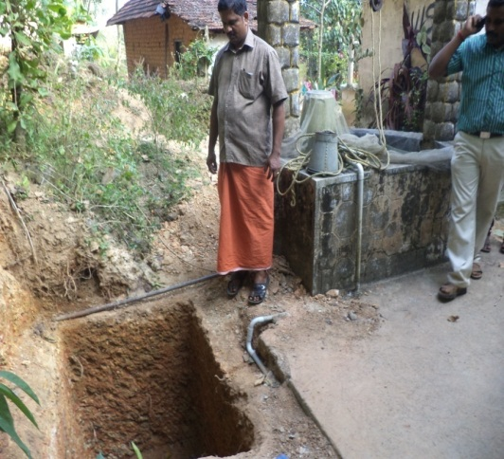
recharge pit

Slide 30
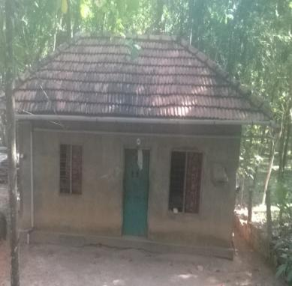
Tiled roof
Pipe alignments

Slide 31
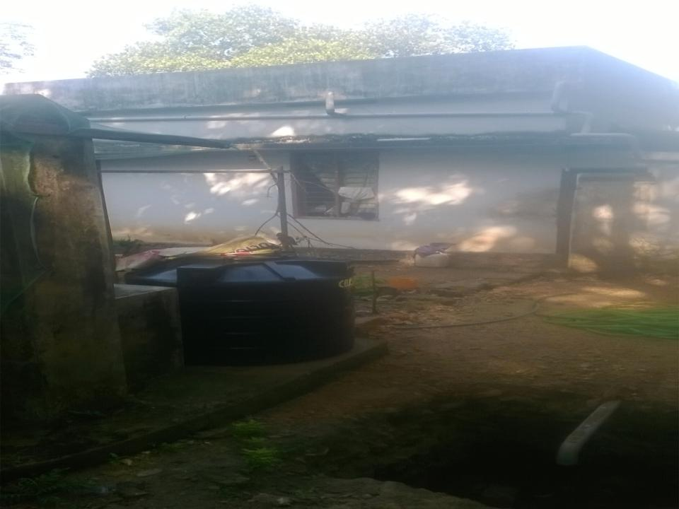
recharge pit

Slide 32
Location of activity
Between 9⁰4’50” and 9⁰5’50” North Latitude
and 76⁰53’2” and 76⁰55’7” East Longitude

Slide 33
THANK YOU

