Slide 1
welcome

Slide 2
I W M P EPA-Pookotupuzha watershed THEKORTH KOLE LAND – Padiyur Grama Panchayath
Vellangallur Block Panchayath

Slide 3
MARSH TURNED AGRICULTURE LAND

Slide 4
Thekorth Kole land consists in Pookottupuzha Watershed
of Padiyur Grama Panchayat in Vellangallur
Pookottupuzha Watershed has the area of 2895 Ha belongs
to Padiyur, Vellangallur, Poomangalam, Vellukkara Grama Panchayats.
662 Ha area and wards of 5, 6, 7,8,10 fully and 4, 9, 11, 12 partially
sanctioned under IWMP in Padiyur Grama Panchayath.
The main occupation of the people was agriculture and animal husbandary.
Thekorth kole land once famous for vegetable and paddy cultivation,
the place has turned into marsh land since the last 10-13 years

Slide 5
Thekorthkole padam before implementation

Slide 6
Saline intrusion in summer and floods in monsoon was a regular phenomenon in the area.
Silt deposits over the years obstructed the natural flow of water at many places causing the lands to become waterlogged and marshy.
Paddy in wetlands and coconut, Arecanut in uplands are the major crops in the area. Farmers also grow banana and vegetables as intercorps in uplands.

Slide 7
The soil of this region is generally sand to loamy sand.
Watershed is an area of land where all of the water that is under it or drains off of it goes into the same place. In 2013, when the government sanctioned a watershed
management programme through phase IV in Vellangallur PIA. Thekorth kole land selected as entry Point activity in IWMP.

Slide 8
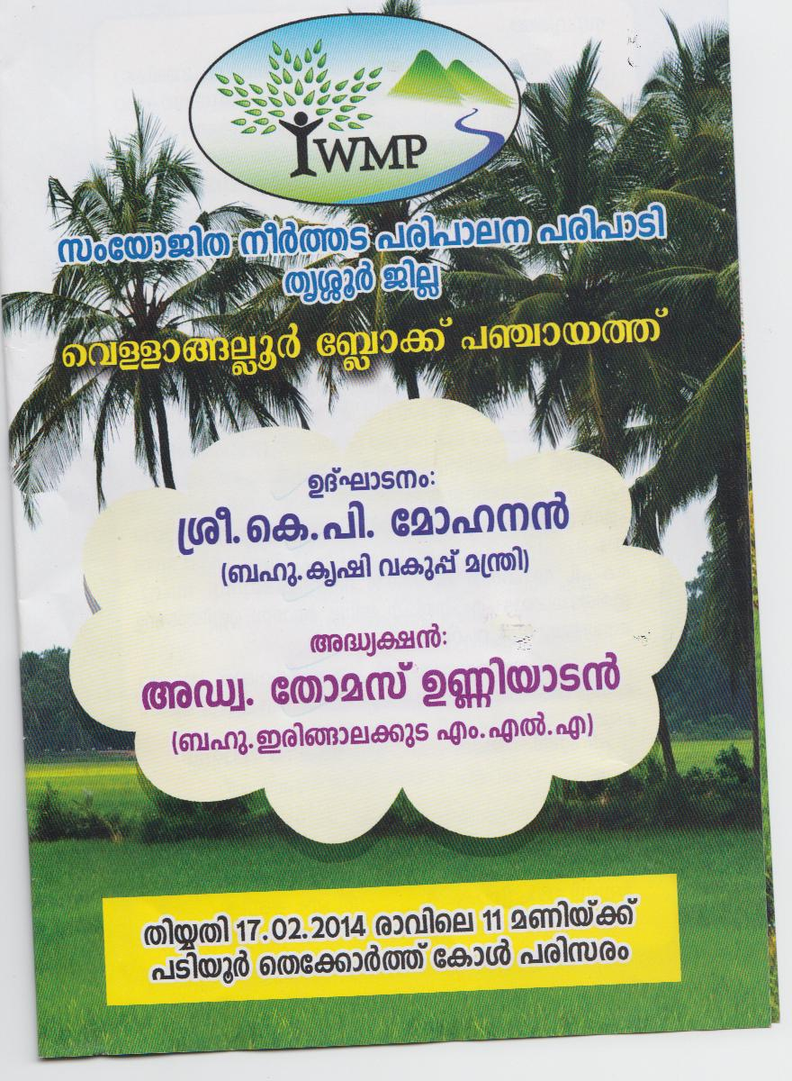
Inauguration notice prepared under iwmp epa

Slide 9
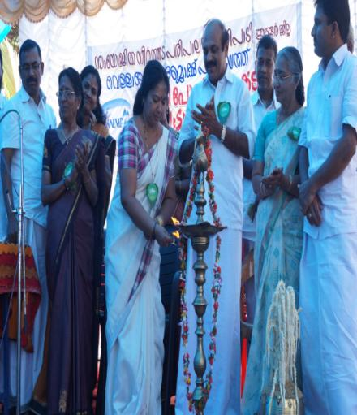
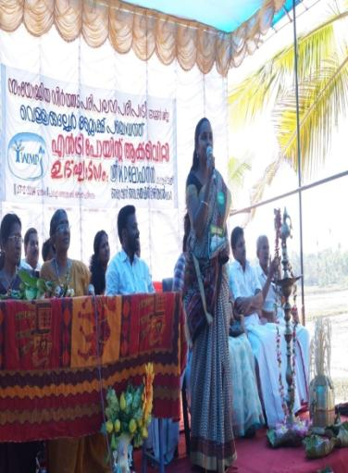
LAMPING OF EPA WORKS

Slide 10
Thekorth Kole land consists of 32 families having area of 20 acre.
The development plan for this land has three main units viz., IWMP, MGNREGS and farmers group

Slide 11
Under farmers group, the 32 farmer’s formed as a single unit and contributed money for this .using their fund, they installed pump, motor shed. They collect 182kg of paddy seeds, fertilizers (Urea, Potash, factomphose etc.) manures etc. The farmers drained water from the kole land.

Slide 12
Under MGNREGA the labours cleaned the marshy land. The work started on January. MGNREGA could meet 2007 labour days through 3 stages. The amount utilized for this were 3, 69,656/-

Slide 13
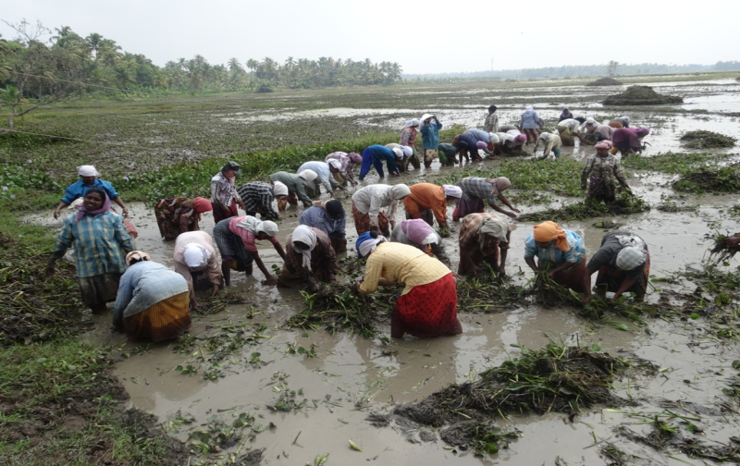
LAND PREPARATION OF PADDY FIELD

Slide 14
EPA WORK STARTED WITH MGNREGS WORKERS

Slide 15
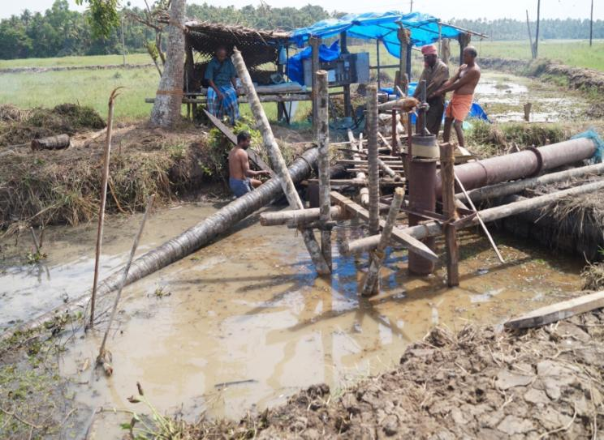
Draining of water from the kole land

Slide 16
Reports from newspapers

Slide 17
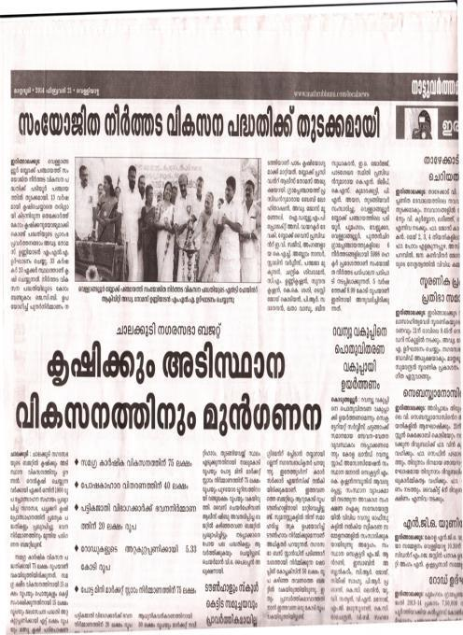
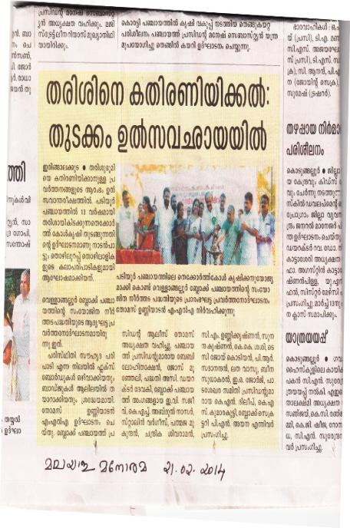

Slide 18
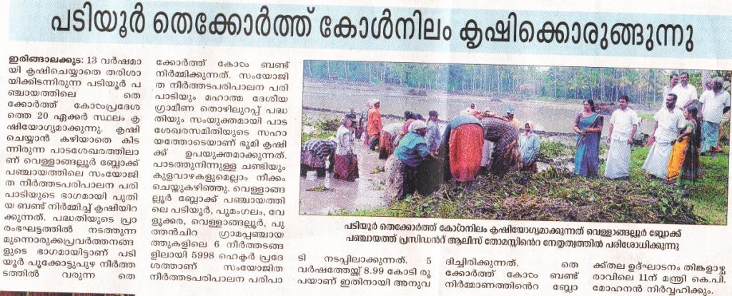

Slide 19
Under IWMP, bund constructed along the land. The IWMP fund met for this were 332170/- . Land preparation, sowing, transplanting, weeding, mannuring, irrigationing and harvesting were integrated by the above units. All the activities were ended on May last.

Slide 20
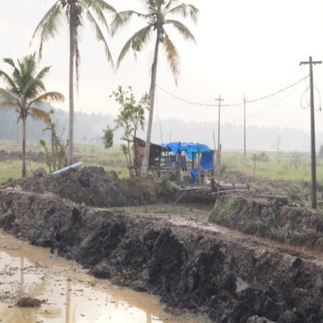
Thekkorthkole Bund Construction

Slide 21
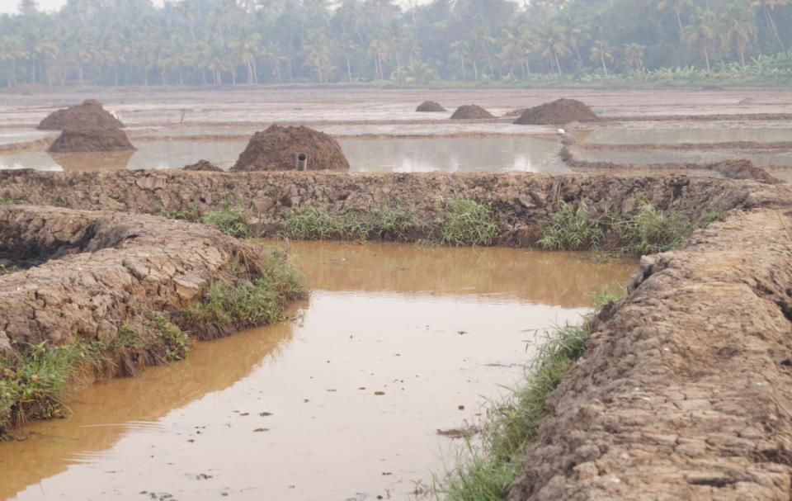
Completed Bund Construction

Slide 22
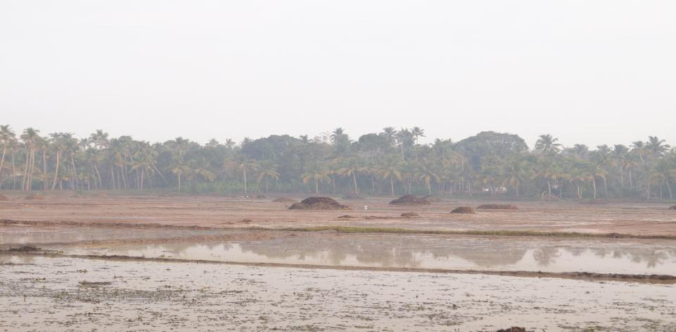
Land ready for receiving seeds

Slide 23
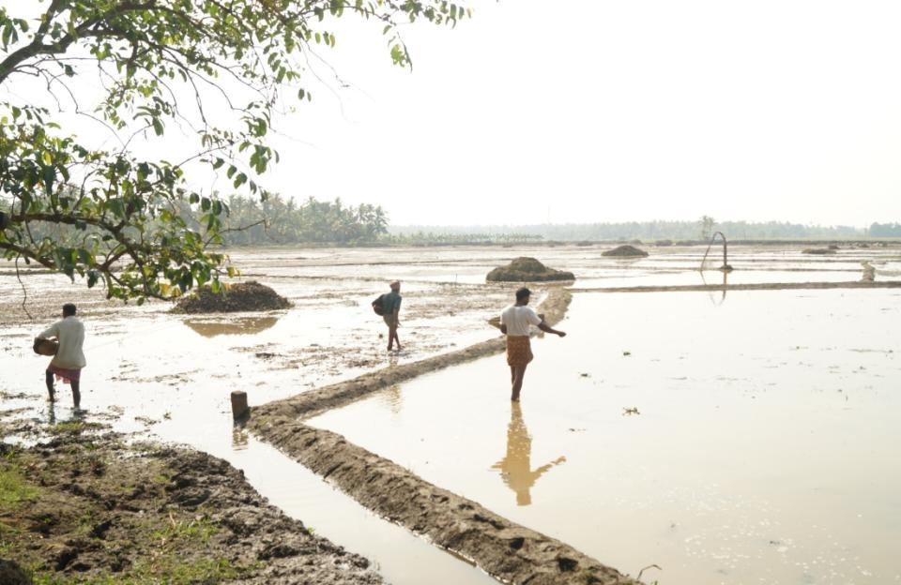
Sowing paddy seeds

Slide 24
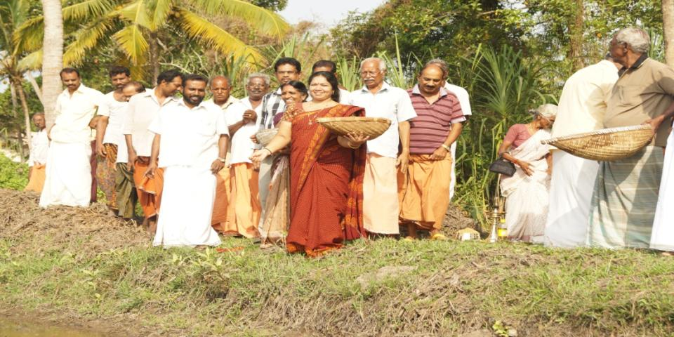
Sowing of paddy seed inagurated by Block president Alice Thomas

Slide 25
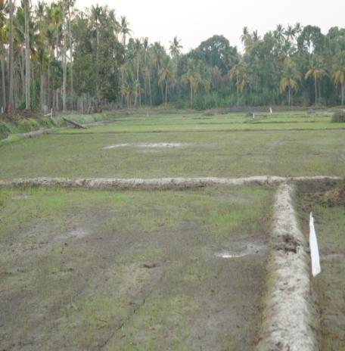
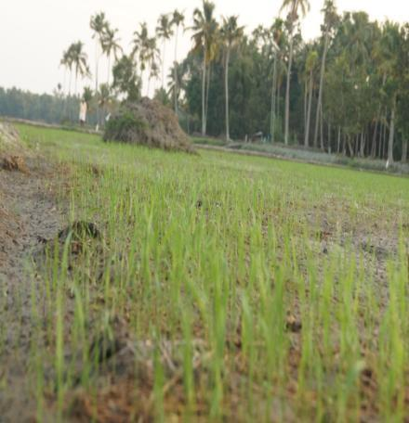
Sprouting of paddy seed

Slide 26
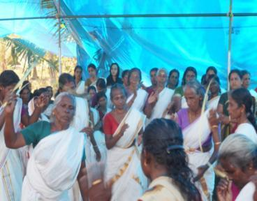
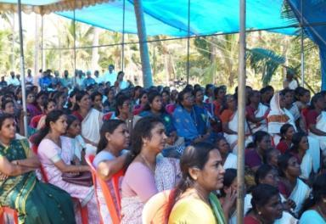
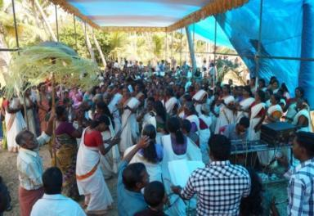
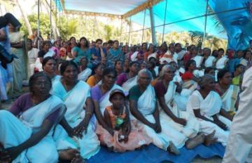
Farmers celebrated harvesting as a festival

Slide 27
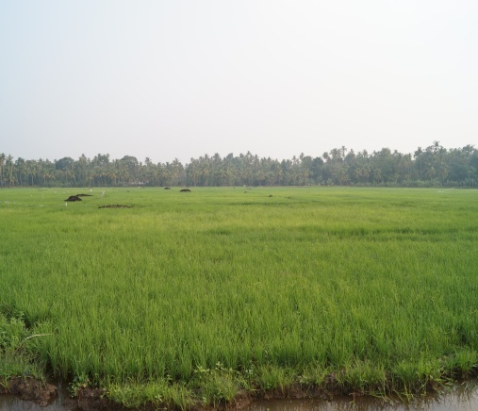
land fully covered with paddy

Slide 28
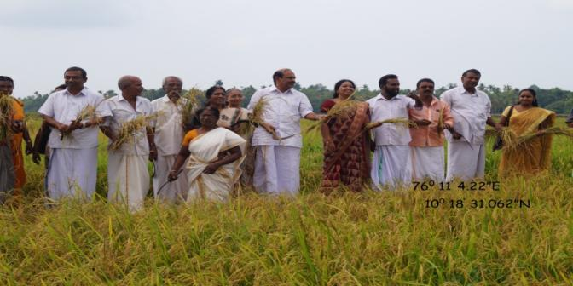
harvesting ingurated by Irijalakuda MLA shri.adv. Thomas unniyadan

Slide 29
The treatment has helped waterlogged area become fertile cultivable.

Slide 30
Thanks

